Slide 1
Introduction
System: A system is a set of component that works together to performs a specific task. It accept input than processes it and give the required out put.
It is a set of interacting or interdependent object or idea which works together like a single unit in order to achieve common goal.

Slide 2
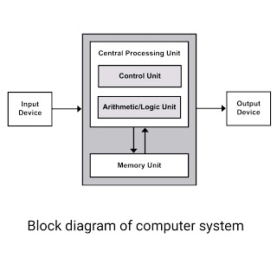
Block diagram of computer system

Slide 3
Cont..
Information System: Information system is a system which process supplied/ collected data and generates information that can be used for decision making at different levels.
An information system is a computer based system which is an integrated set of different components for collection, process, storage and transmission of data.

Slide 4
Different between data and information
Data | Information
Data is unorganized and unrefined facts | Information comprises processed, organised data presented in a meaningful context
Data is an individual unit that contains raw materials which do not carry any specific meaning. | Information is a group of data that collectively carries a logical meaning.
Data doesn’t depend on information. | Information depends on data.
It is measured in bits and bytes. | Information is measured in meaningful units like time, quantity, etc.
Raw data alone is insufficient for decision making | Information is sufficient for decision making
An example of data is a student’s test score | The average score of a class is the information derived from the given data.

Slide 5
Component of information system
Hardware: Physical layers of the information system.
Software: logical layers of information system that makes hardware function properly.
Data: Data is raw facts, figures, and measurement etc. which are used as input for the system.
Processes: processes, or procedures, describe the tasks that users, managers, and it staff.
People: people refers to users who interact with information system.

Slide 6
Software project management
What is Project Management?
Project Management is the art of maximizing the probability that a project delivers its goals on Time, to Budget and at the required Quality.
Project management is the application of knowledge, skills, tools, and techniques to project activities to meet project requirements.

Slide 7
Cont…
What is project?
A project is an activity with specific goals which
takes place over a period of time. Projects have following unique characteristics or attributes:
Temporary:
Unique, Product Service or Result:
Aims/Tasks/Purpose:
Limited Time Scale:
Uncertainty:

Slide 8
Concept of software development process
Software project management is the accomplished through the use of the process such as:
initiating,
planning,
executing,
controlling, and closing.

Slide 9
Cont..
Software project management is the art and science of planning and leading software projects. It is a sub-discipline of project management in which software projects are planned, implemented, monitored and controlled. Software project management comprises of a number of activities, which contains
planning of project,
deciding scope of software product,
estimation of cost in various terms,
scheduling of tasks and events,
and resource management.

Slide 10
Concept of SDLC life cycle.
SDLC is a systematic process for building software that ensures the quality and correctness of the software built. SDLC process aims to produce high-quality software that meets customer expectations. The system development should be complete in the pre-defined time frame and cost. SDLC consists of a detailed plan which explains how to plan, build, and maintain specific software. Every phase of the SDLC life Cycle has its own process and deliverables that feed into the next phase. SDLC stands for Software Development Life Cycle and is also referred to as the Application Development life-cycle

Slide 11
Purposes of SDLC
SOFTWARE DEVELOPMENT LIFE CYCLE (SDLC) •Lead to good software
• Reduce risk
• Enable visibility and measurement
• Enable teaming
• Key attributes
•Outcomes/results of processes are key deliverables or products
•Roles are clear
•Pre and post conditions are understood and held true.

Slide 12
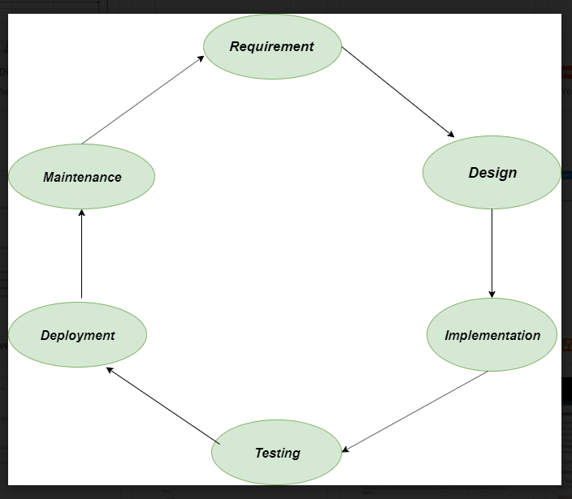
Phases of SDLC

Slide 13
System Analyst
A system analyst is a problem solver. He is a person who sees problem analysis as a challenge and enjoys finding functional solutions. The analyst must be able to systematically attack the situation at hand through the application of tools, experience techniques.
Systems analysts implement, maintain, and support IT and informations systems to meet the business needs of organizations and scale as organizations grow. They analyze and create tests, and develop specifications and requirements for developers and programmers to follow.

Slide 14
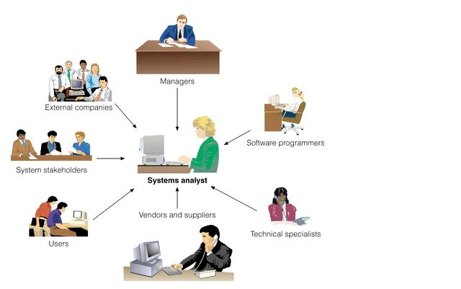

Slide 15
Software engineer
Software engineers is a person who is responsible for design, build, and maintain software systems for electronic devices. A software engineer may operate alone, but typically they spend their time collaborating with other engineers, scientists, and various specialists to come up software with creative .
Software engineers and computer programmers both develop software applications needed by working computers. The difference between the two positions lies in the responsibilities and the approach to the job. Software engineers use well-defined scientific principles and procedures to deliver an efficient and reliable software product

Slide 16


Slide 17
Assignment 1 1. Different between system analyst and software engineer?

Slide 18

Concept of system design

Slide 19
System design
Definition: Systems design is the process of defining elements of a system like modules, architecture, components and their interfaces and data for a system based on the specified requirements. It is the process of defining, developing and designing systems which satisfies the specific needs and requirements of a business or organization.
System design is the process of defining the elements of a system such as the architecture, modules and components, the different interfaces of those components and the data that goes through that system.

Slide 20
Relationship software and Quality
What is software quality?
The quality of software can be defined as the ability of the software to function as per user requirement. When it comes to software products it must satisfy all the functionalities written down in the SRS document.

Slide 21
Key aspects that conclude software quality include Good design – It’s always important to have a good and aesthetic design to please users Reliability – Be it any software it should be able to perform the functionality impeccably without issues Durability- Durability is a confusing term, In this context, durability means the ability of the software to work without any issue for a long period of time.

Slide 22
Consistency – Software should be able to perform consistently over platform and devices Maintainability – Bugs associated with any software should be able to capture and fix quickly and news tasks and enhancement must be added without any trouble Value for money – customer and companies who make this app should feel that the money spent on this app has not fone to waste.

Slide 23
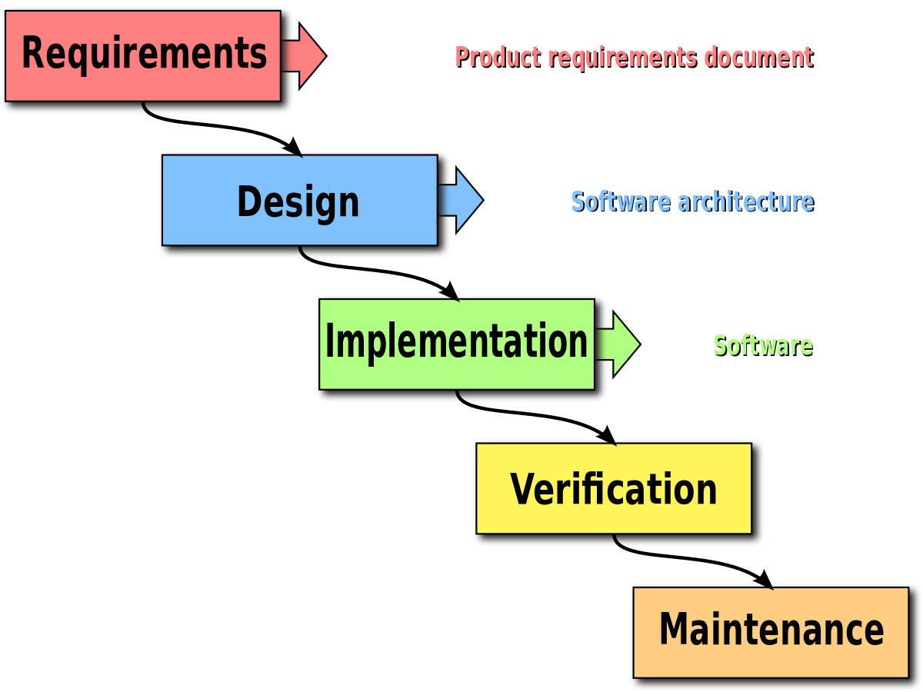
1. Waterfall This model also called classic life cycle because it suggests a sequential approach to software development. Waterfall model is a systematic and sequential model to develop software that beings with customer specification requirement progress through planning modeling and construction. It is only appropriate if all the requirements are known.
Software development Model
There are different types of patter, structure by which software/ system can develop. These patter is known as software development Model. There are different types of model via through software/ system can development. On the base of software/ system size, nature, begets, timeframe software development company can implement different types of model. There model are as follow.

Slide 24
1.Requirements Analysis and Definition: It is the first stage of waterfall model. In this stage, the developer should identify the actual requirement of the given problem. 2. Design: In this stage the system design process partition the requirement in two part: i. Requirement gathering and analysis: First all the information and requirement for the product development is gathered from the customer and then it is processed for analysis. ii. Requirement specification: Then, the above-analyzed requirements are documented in an SRS (software requirement specification ) document. It serves as a path between the customer and the SRS development team.
Cont…

Slide 25
Implementation and unit testing: During this stage the system design is realized as a set of programs or program unit testing involves verifying that each unit meets its specification. Integration and system Testing: Now in this phases individual program units or program are integrated and tested as a complete system to ensure that the software requirements have been met. After testing the software system is delivered to the customer.

Slide 26
Advantages : It is simple suitable for small size project. It is less expensive Disadvantages: It has no back track mechanism. It is not suitable for large size project. it has lack of proper documentation.
Operation and maintenance: In this stage the system in installed to the desire location. The maintenance involves correcting errors which were not discovered in earlier stages of the life cycle improving the implementation of system units and enhancing the system’s service as new requirements are discovered.

Slide 27
Prototype model The prototype model is the methodology of a working prototype or doing the work that comes first to the developer and creates the sample of it. The system that needs processing of data on a large scale and functionality with fewer interfaces does not get benefit from prototyping. It can be extra work for the developer to do.
Identify user Requirement
Develop a prototype
Prototype
acceptable
no
yes
Use the prototype

Slide 28
Prototyping
Prototyping is the iterative process of system development which is more appropriate where there is no clear of requirement, input and outputs using prototyping programmers can build early version of systems. These system are then continuously modified until the user is satisfied. Developing a type of prototype, there are mainly steps:
Identify user requirement:
Development a prototype:
Determine if prototype is acceptable:
Use the prototype:

Slide 29
Cont..
Identify the user requirement: The system analyst is responsible to obtain an idea and concept what is required from the system by using different tools like interview, observation, conversation, data collection.
Develop a prototype: In this stage system analyst deliver the document which are collection from the user to the information specialists to develop the one or two prototype tools to develop a prototype.

Slide 30
Cont…
Determine if prototype is acceptable: In this stage analyst is responsible to introduce the different prototype and provides an opportunity from becoming familiar with the system. After that the user advise the analyst whether the prototype is satisfactory. If so then next step else the prototype is revised by repeating from steps 1,2,3respectively until the costumer is not satisfied with the prototypes.
Use the prototype: The prototype which is accepted by the user will become the operational system.

Slide 31
Cont..
Assignment 1:
2.What is prototype model? Write its advantage and disadvantage.

Slide 32
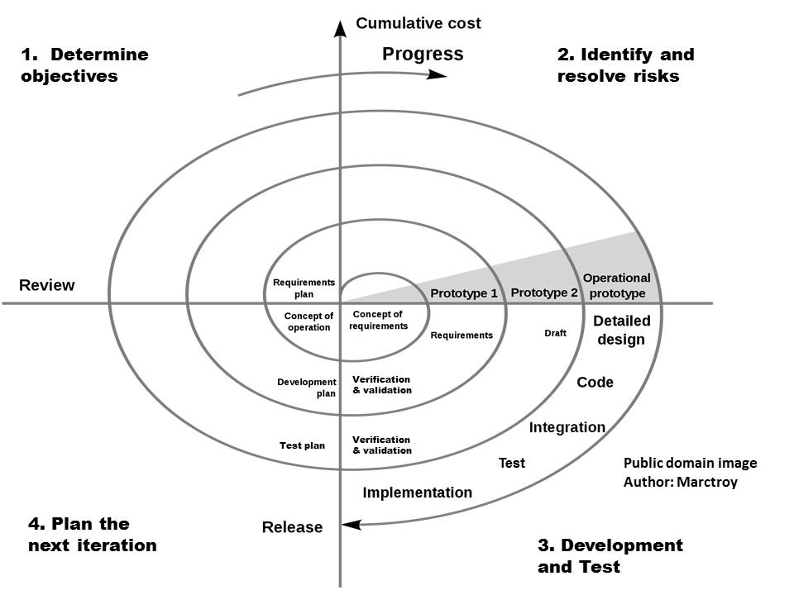
Spiral Model

Slide 33
Spiral model
The spiral model is one of the Software development life cycle model which is made by combining both iterative model and waterfall model. The Spiral model first introduced by Barry Boehm in 1986. To explain briefly Spiral Model is a Model where after each phase, it gets tested, and errors or mistakes are done by us are get handled. Each phase of the Spiral Model starts with design objectives and ends with a client review.

Slide 34
Cont..
Spiral model is a system development method in looping structure, in this model planning, risk analysis, software development and user evaluations are repeatedly processed until the system performs correct output.

Slide 35
Cont…
Planning:- The project is reviewed and a decision made whether to continue with a further loop of the spiral. If it is decided to continue, plans are drawn up for the next phase of the project.
Risk analysis: For each of the identified project risks, a detailed analysis is carried out. This step is responsible is for the reduce the risk.

Slide 36
Cont…
Software development: After risk evaluation, a development model for the system is chosen. For example if user interface risks are dominant, an appropriate development model might be evolutionary prototyping. If safety risks are the main consideration, development based on formal transformations may be the most appropriate development model if the main identified risk is sub-system integration.

Slide 37
Assignment 1
What is spiral model? Write its advantage and disadvantage.

Slide 38
Agile Model
Agile SDLC Model is a combination of iterative and incremental process models with focus on process adaptability and customer satisfaction by rapid delivery of working software product.
Agile methods break tasks into smaller iterations, or parts do not directly involve long term planning. The project scope and requirements are laid down at the beginning of the development process. Plans regarding the number of iterations, the duration and the scope of each iteration are clearly defined in advance.

Slide 39
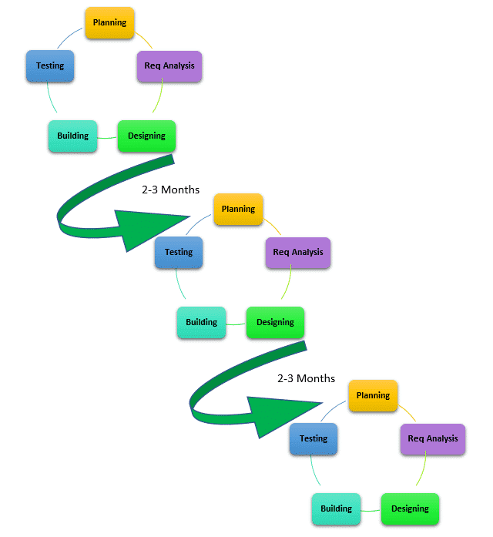
Cont..

Slide 40
Cont..
Every iteration involves cross functional teams working simultaneously on various areas like-
Planning
Requirement analysis
Design
Coding
Unit testing
Acceptance testing.

Slide 41
Assignment 1
question no 4
Write the concept of Agile model? Writes its advantage and disadvantage.

Slide 42
Requirement Collection method
Requirement collection is an importance work for SDLC. There are different tools and technique to collect the requirement for SDLC.
Brainstorming: it used in requirement gathering to get as many ideas as possible form group of people.
Interview: interview of stakeholder and users are critical to creating the great software. Without understanding the goal and expectations of the users and stakeholders, we are very unlikely to satisfy them.
Observation: By observing users an analyst can identify a process flow, steps pain point and opportunities for improvement.

Slide 43
System Analysis
System analysis is the survey and planning of the system and project
The study and analysis of the existing business requirement and information system.
Defining of business requirements and priorities for a new or improved system.
Feasibility study:- Feasibility analysis is the most important activity in the system analysis phase.

Slide 44
Cont..
Feasibility study is e the study of whether the system is feasible or not to design. It consist
Economical Feasibility :- it concern with cost effectiveness of the system. The main objective of economic feasibility is to calculate approx cost of the development cost and the operational cost and the benefits from the system.

Slide 45
Technical feasibility:- Technical feasibility is total concern with availability of the hardware, software and the support equipment for the complete development of the system.
Operational feasibility:
Behaviors feasibility:
Schedule feasibility:
Legal feasibility:

Slide 46
System design
System design is the process to transform user requirements into some suitable form, which help programmer in software coding and implementation. Tools are:
Srs
Flowchart
Algorithm
DFD(Data flow diagram)
ERD(Entity relationship diagram)

Slide 47
Cont..
There are a mainly two types of system design strategies:
1. Top Down Mythology:-
2. Bottom up Methodology

Slide 48
Cont.
System Testing: system testing can be consider as the process of validation and verification of program/application/ product.
Some major method are :
White box testing
Black box testing

Slide 49
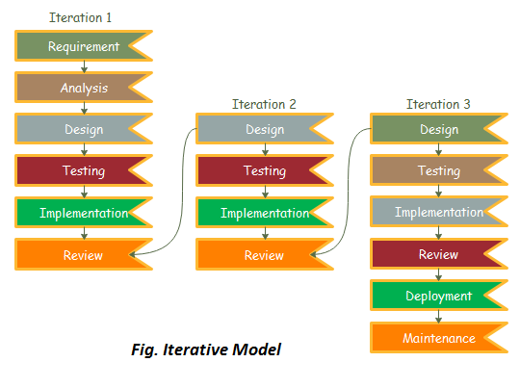
Iterative value
In iterative Model, project start with some of the software specifications and develop the first version of the software. After the complet of first version software, if there is a need to change the software, then a new version of the software is created with a new iteration. Every release of the Iterative Model finishes in an exact and fixed period that is called iteration.

Slide 50
Which condition Iterative mode is implented.
When requirements are defined clearly and easy to understand.
When the software application is large.
When there is a requirement of changes in future.

Slide 51
Evolution development model
Evolutionary model is a combination of Iterative and Incremental model of software development life cycle.
Delivering your system in a big bang release, delivering it in incremental process over time is the action done in this model.
It is better for software products that have their feature sets redefined during development because of user feedback and other factors.
The Evolutionary development model divides the development cycle into smaller, incremental waterfall models in which users are able to get access to the product at the end of each cycle.

Slide 52
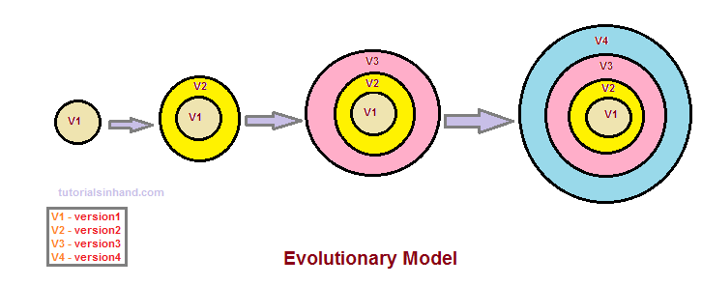

Slide 53
Evolutionary model suggests breaking down of work into smaller chunks, prioritizing them and then delivering those chunks to the customer one by one.
It is used in large projects where you can easily find modules for incremental implementation. Evolutionary model is commonly used when the customer wants to start using the core features instead of waiting for the full software.
Conditions for implementing this model
Customer needs are clear
higher the risk so report to customer repeatedly.
It is used when working on a technology is new and requires time to learn.

Slide 54
Home task
Describe pro and con of iterative and evolution model.

